Slide 2
Presentation Title
Le Tuan Hung l Agentic AI the next through of Generative AI

Slide 3
Agentic AI – The Next Breakthrough After GenAI
1. What is Generative AI and Agentic AI ?
2. The development of GenAI and why it’s not enough
3. The upgrade from GenAI to Agentic AI
4. Applications & Future of Agentic AI
5. Q&A
Section Title Goes Here
Section Title Goes Here
Section Title Goes Here

Slide 4
What is the GenAI and Agentic AI

Slide 5
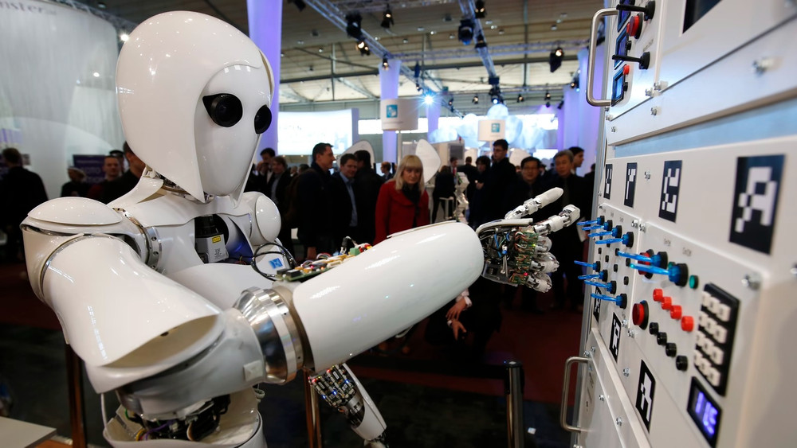
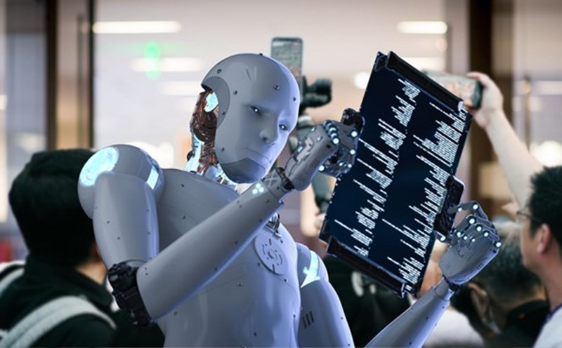
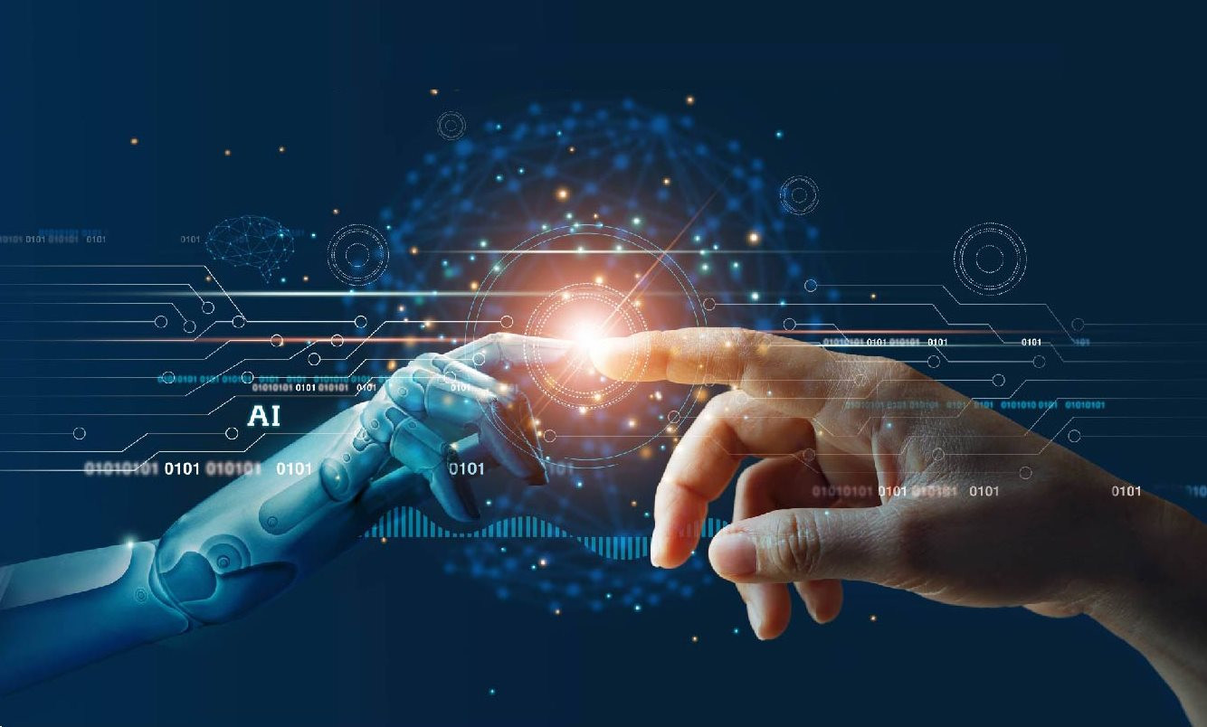
Agentic AI The next breakthrough after GenAI

Slide 6
Why AI exploded recently
Why not earlier
AI is not new, actually it’s been around for over a decade
The question is why it’s only now becoming so prevalent in daily life and work ?
To explore about Agentic AI, we must understand the roots of this explosion

Slide 7
Follow AP Style Guidelines for All Content
Before Transformer
Sequential processing
Poor context
Hard to scale
Transformer
Full context
Parallel processing
Better understanding
Example
I can’t fit the laptop into the bag because it’s too big
I can’t fit the laptop into the bag because it’s too small

Slide 8
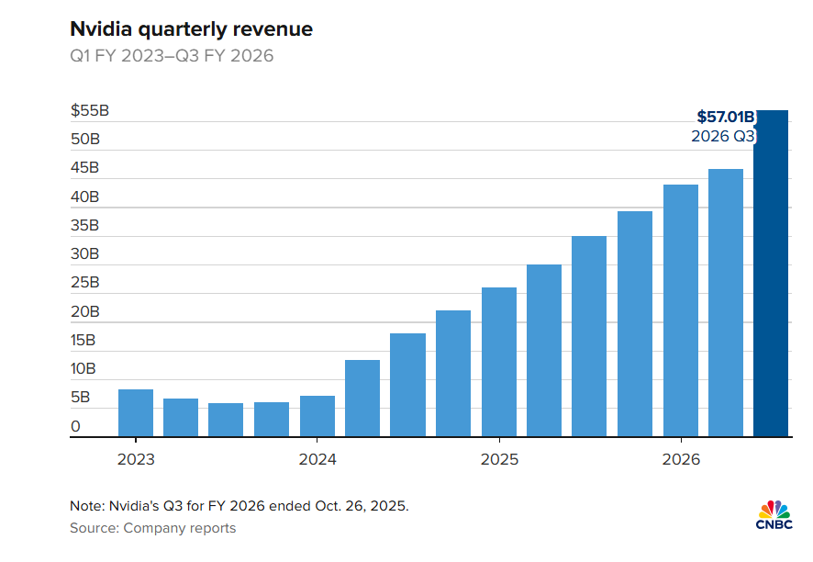
Follow AP Style Guidelines for All Content
Delete this instructional slide when creating a new presentation
Transformer
Full context
Parallel processing
Better understanding
Transformer + GPU = AI explosion
Increase value in NVIDIA

Slide 9
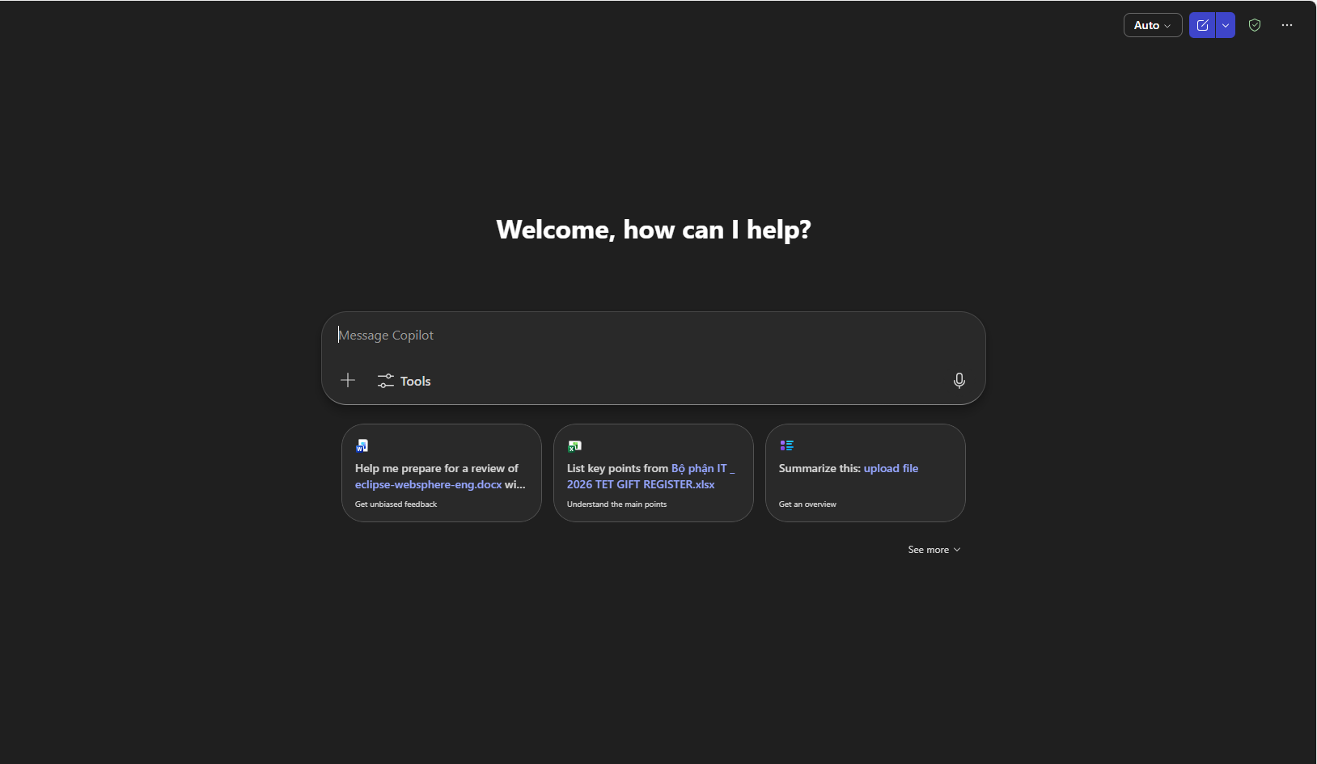
Generative AI
Generative AI
Chat
Code
Content

Slide 10
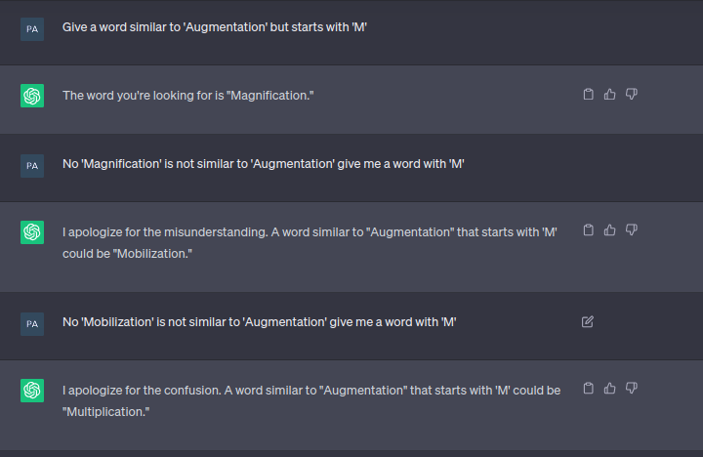
Hallucination
Fake answer
Short-term memory

Slide 11
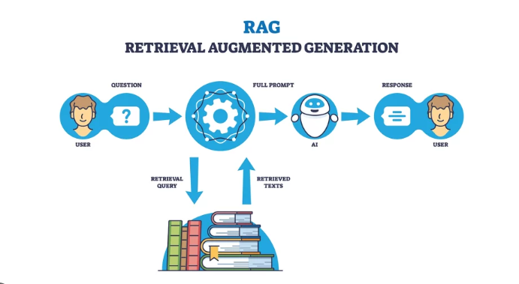
Hallucination
AI bubble -> human hands
RAG = AI + Enterprise Data
=> Knowing, but it is not doing

Slide 12
Agentic AI

Slide 13
Agentic AI
It can watch the word, remember context, decide what to do next, and keeps iterating until a measurable goal is reached

Slide 14
Agent Loop
Reason
Act
Observe
Repeat
Like a junior enginnering

Slide 15
Applications and Future of Agentic AI

Slide 16
Applications
Log analysis agent
Collect logs
Detect anomalies
Summarize issues

Slide 17
MES/SPC
Factory use case
Monitor SPC data
Detect OOS
Early warning

Slide 18
Human Role
Human
Set goals
Review results
Make decisions

Slide 19
Key takeaway
GenAI = Talk
Agentic AI = Work

Slide 20
Key takeaway
Agentic AI is not future
It’s starting now

Slide 21
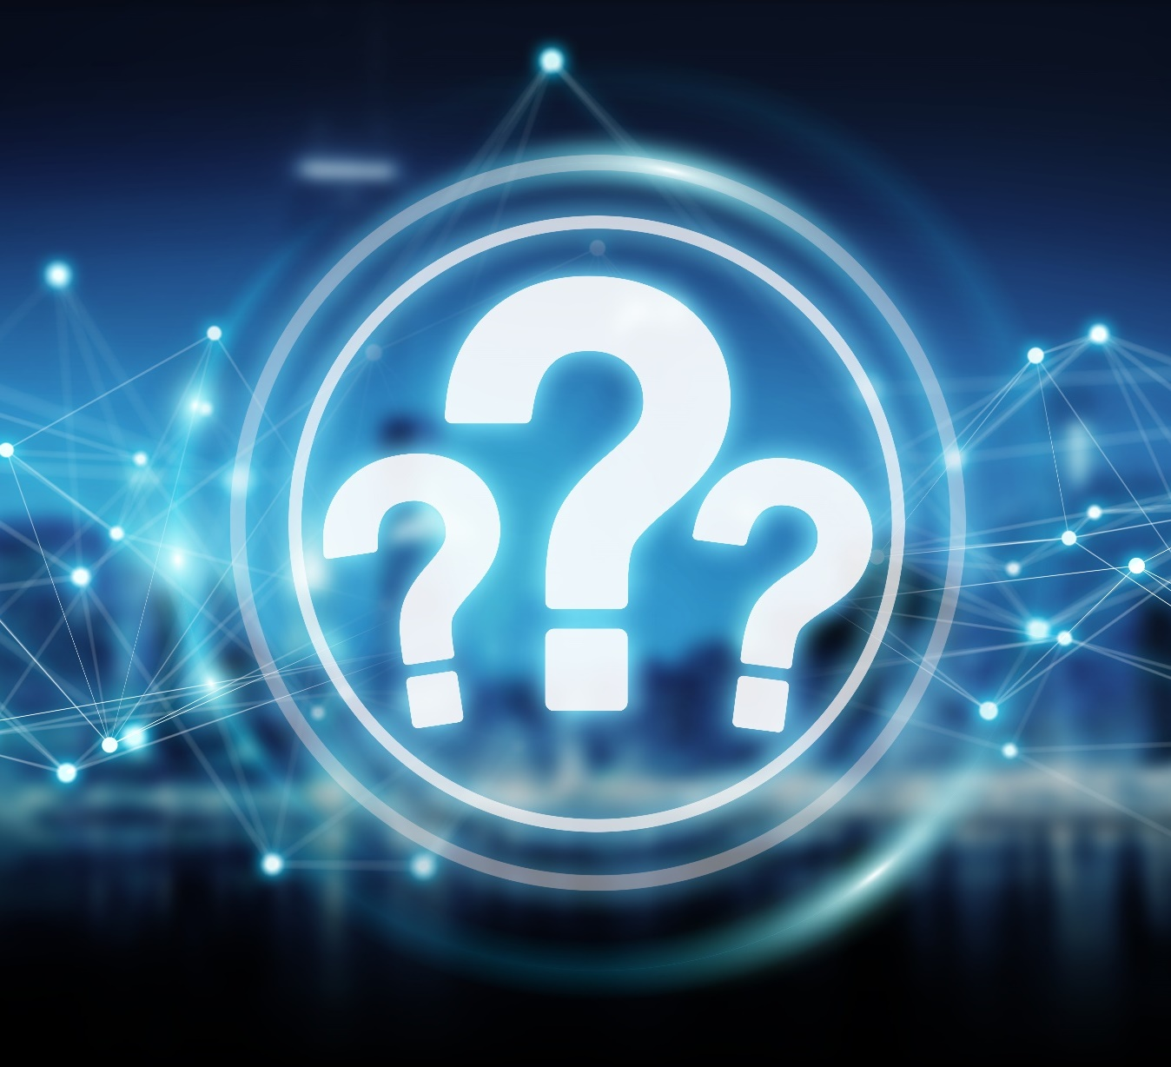
Q&A

